Slide 1

Bangladesh University Of Textiles
Project Title:
A Sustainable Approach: A Scope of Using the Solid Textile Cotton Wastage in Hygiene Product (Sanitary Pad) Manufacturing

Slide 2
This project is
Supervised By,
Md. Abdullah Al. Mamun
Assistant Professor,
Dept. of Fabric Engineering
Presented By,
Md. Shihab Alam
2016-1-2-019
Md. Saiful Islam
2016-1-2-050
Tanmoy Mitra
2016-1-2-051

Slide 3
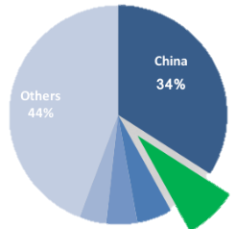
TEXTILE CONTRIBUTION
Textile Industries | Unit in number
Spinning | 425
weaving | 400
Knitting | 2500
Garment | 4621
Germany 4%
Vietnam 5%
Bangladesh 8%
Italy 5%
351,000 tons wastes annually

Slide 4
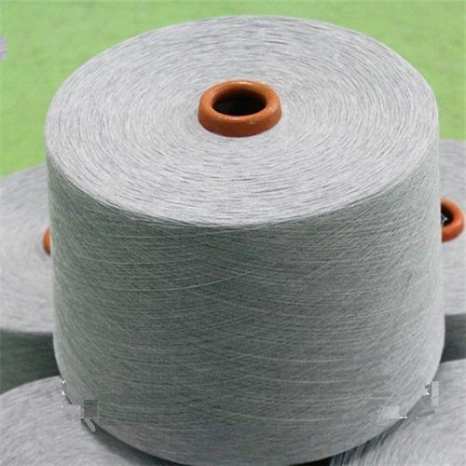
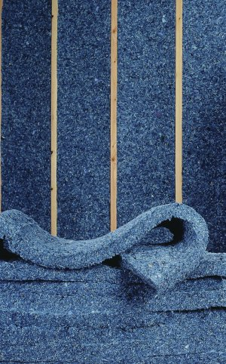

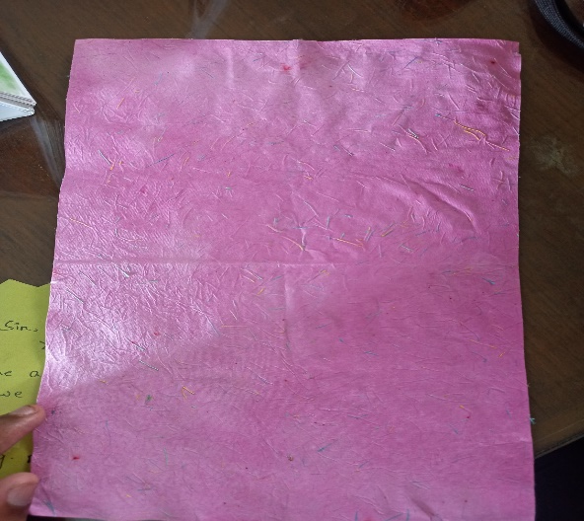
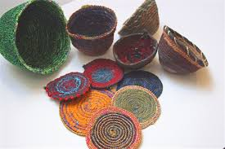
Uses of recycled textile wastages
PCW Yarn
Insulation Cloth
Wicking Cloth
Paper
Decorative Product

Slide 5
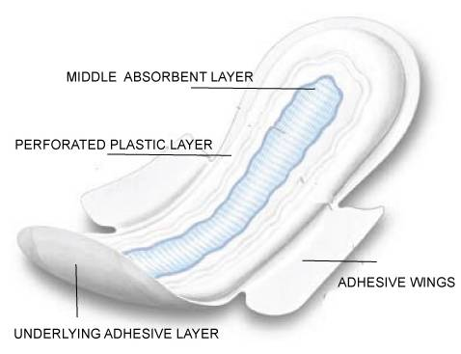
Scope
All the materials used for manufacturing of sanitary are imported. If any of the material can be replaced by textile wastage, it will be a huge contribution for sanitary napkin industry and the price also can be minimized.
Replacement of fluff Pulp of absorbent layer by cotton is the main focus of this project.

Slide 6
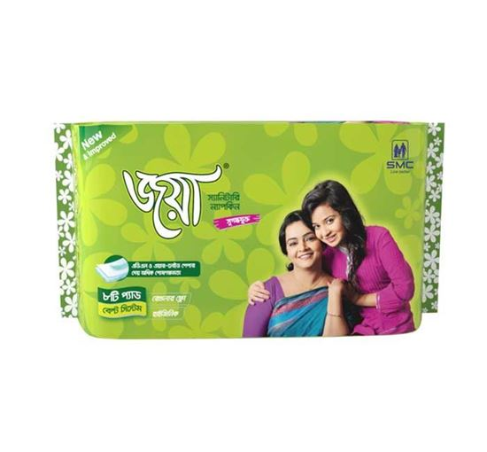

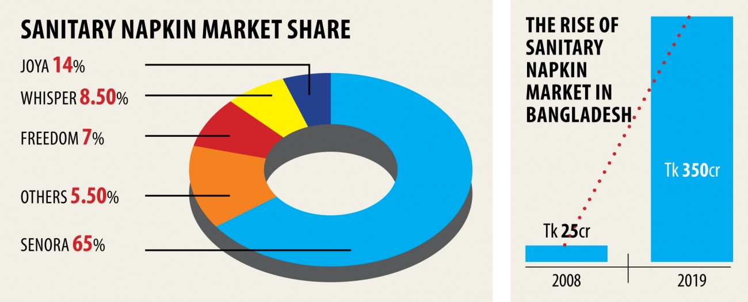
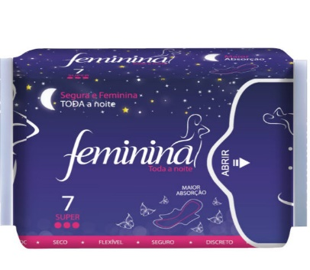
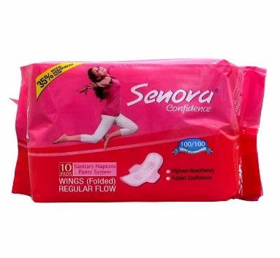
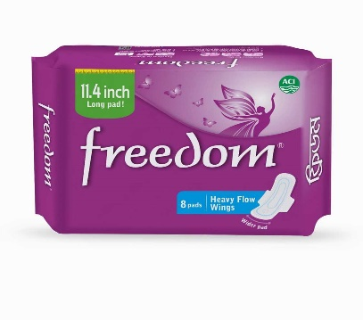
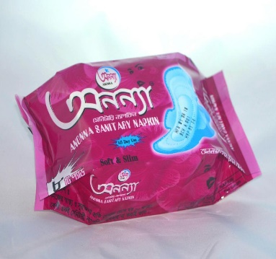
Market Scenario
Some available pads in market
Market share and growth

Slide 7
Objectives
The objectives of our project are:
To produce sanitary napkin from Textile cotton wastage
To produce sanitary pad at a affordable price
To reduce the environmental pollution

Slide 8
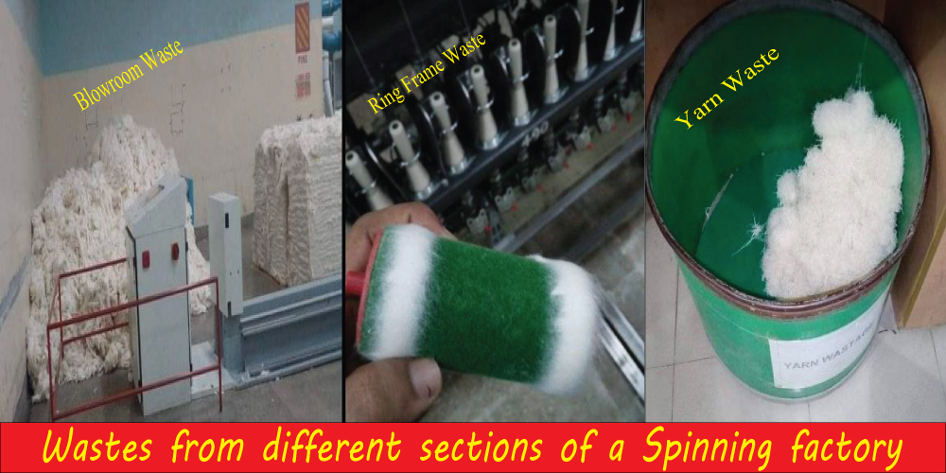
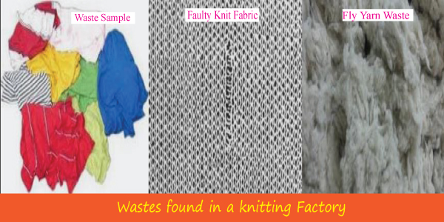
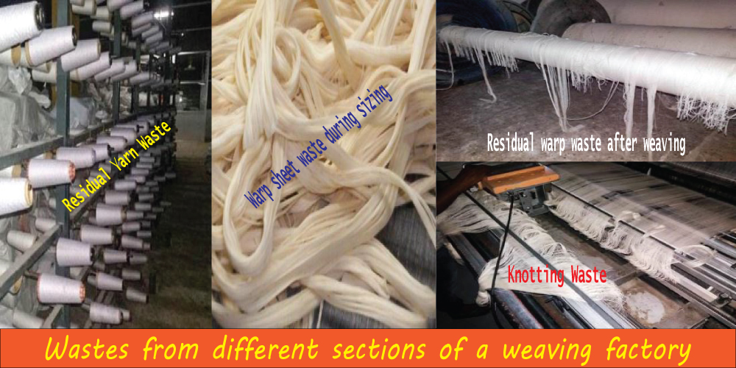
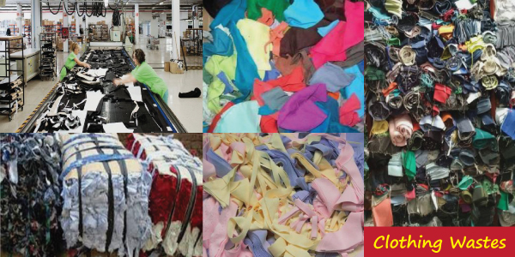
Raw Materials
Wastages from different section are used as raw material:-
Spinning Industry Wastage
Knitting Industry Wastage
Weaving Industry Wastage
Garment Industry Wastage

Slide 9
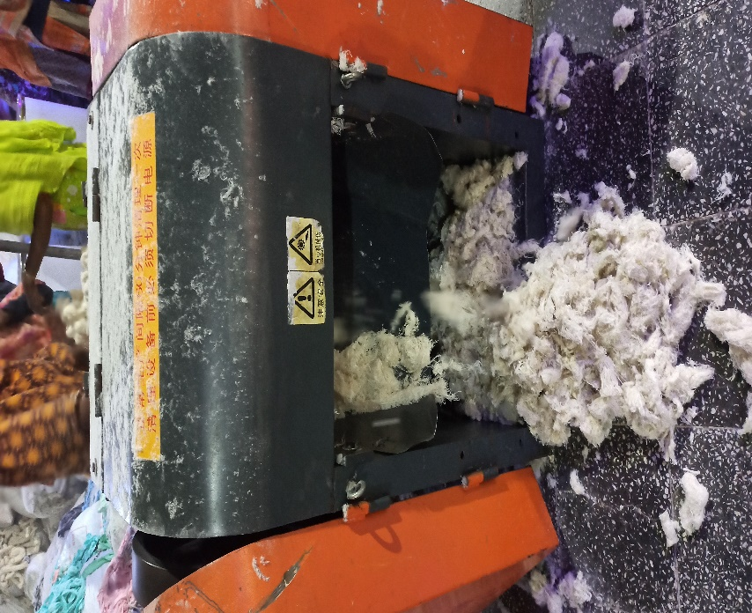
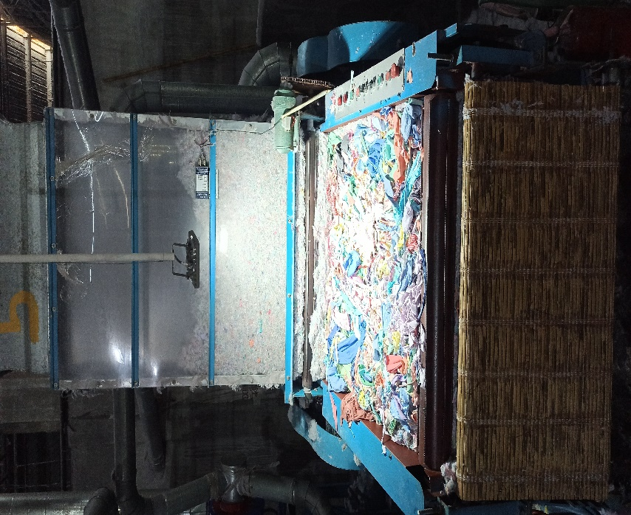
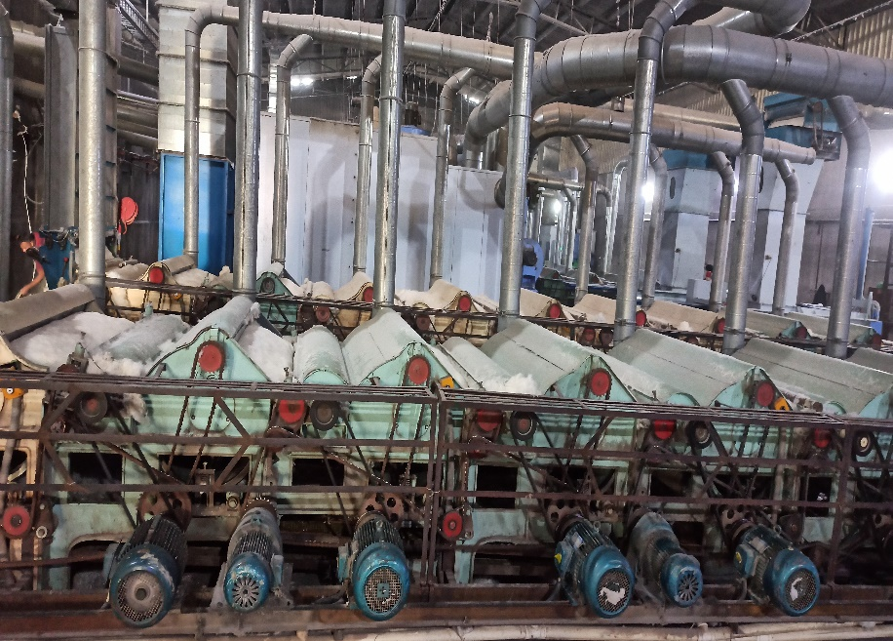
Recycling Process of Wastage
Opening & Cleaning
Cutting
Tearing

Slide 10
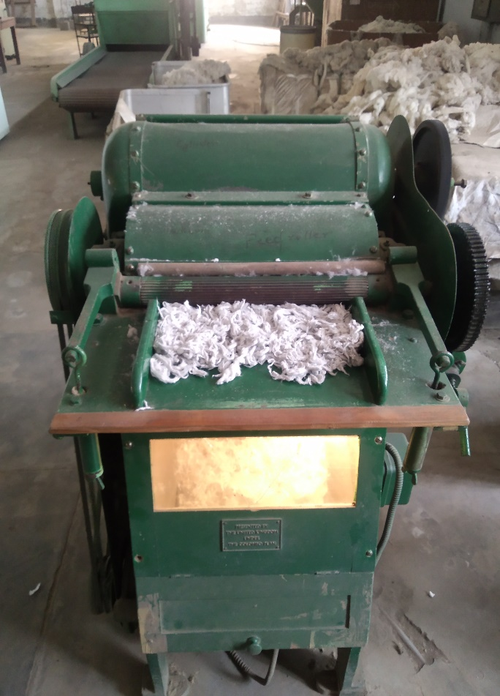
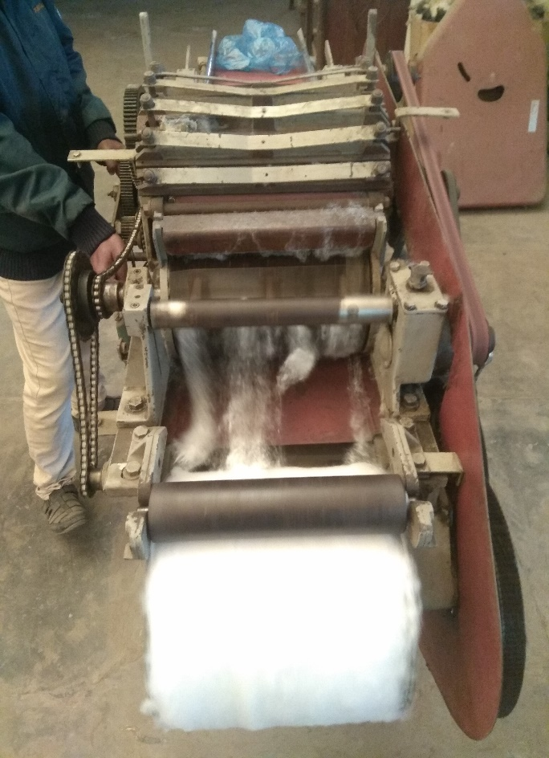
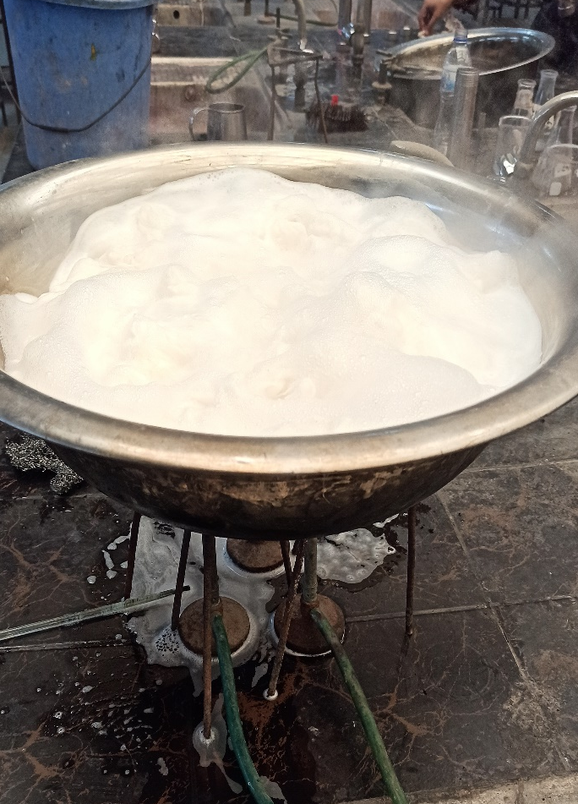
Processing of raw materials
Bleaching/Stripping
Trash analyzing
Carding

Slide 11
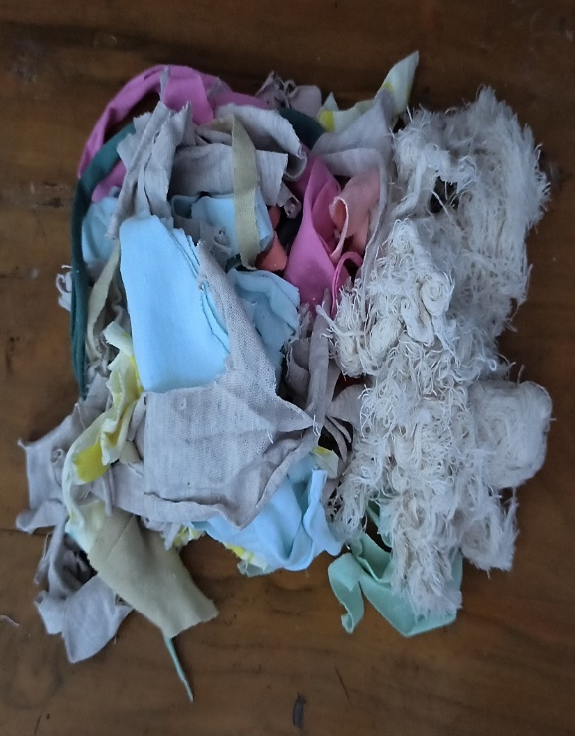
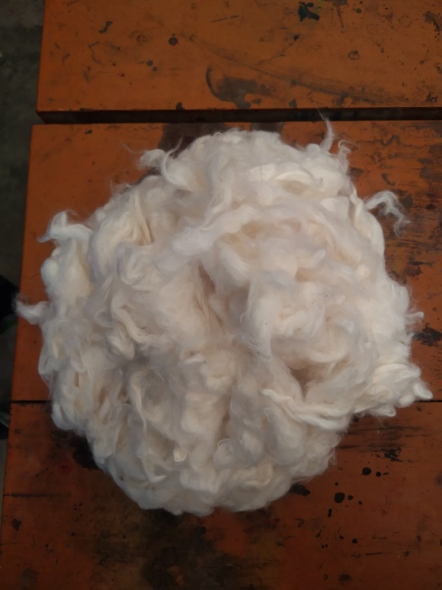
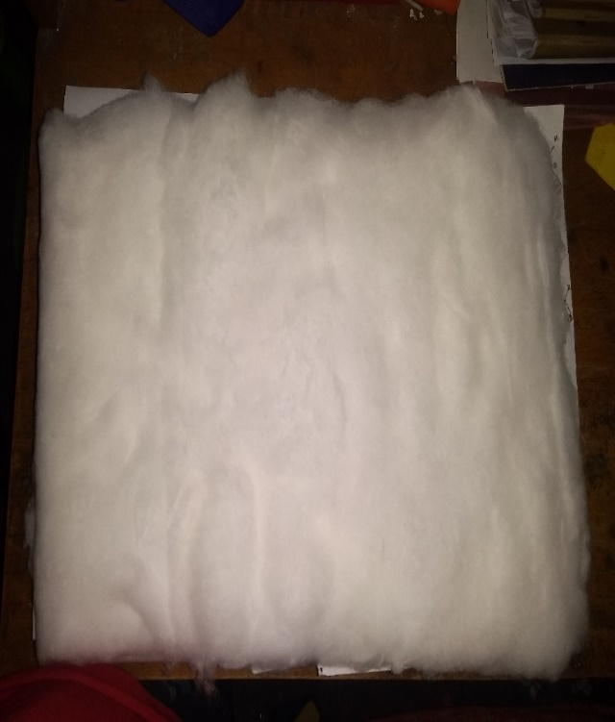
Different forms of Raw materials
Wastages
Fiber
Carded Lap

Slide 12
Production process
There is 5 steps of sanitary napkin production;
Crashing
Compressing
Wrapping
Sterilizing
Packaging

Slide 13
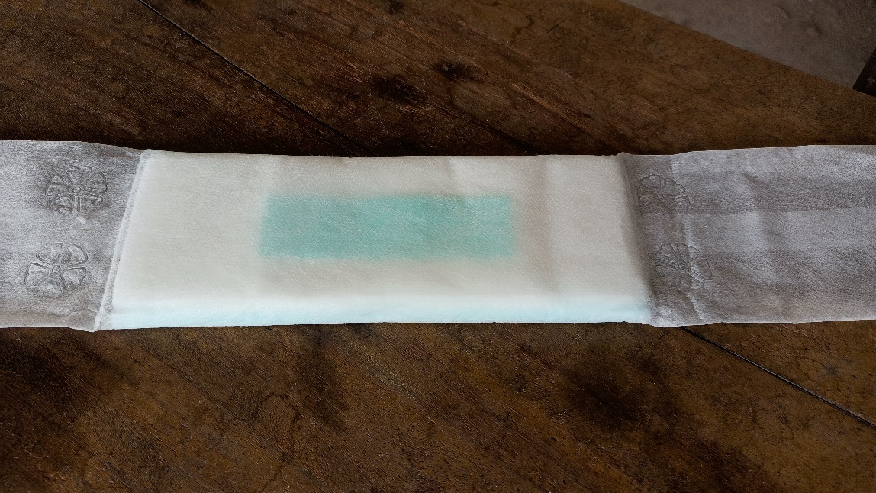
Produced Sample
Dimension of produced sample:
Parameters | Value(average)
Length | 198 mm
Width | 68 mm
Thickness | 14 mm
Weight | 15 gm

Slide 14
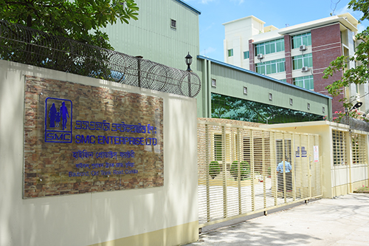
Different types of tests
The following Tests are carried out:
Absorption Capacity Test
P^{H} Test
Ability To withstand Pressure After Absorption
Penetration Test
Antimicrobial Test

Slide 15
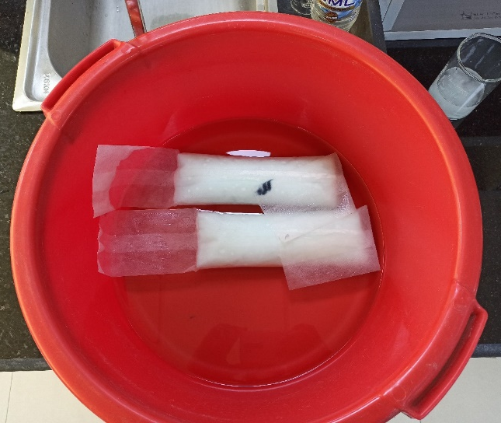
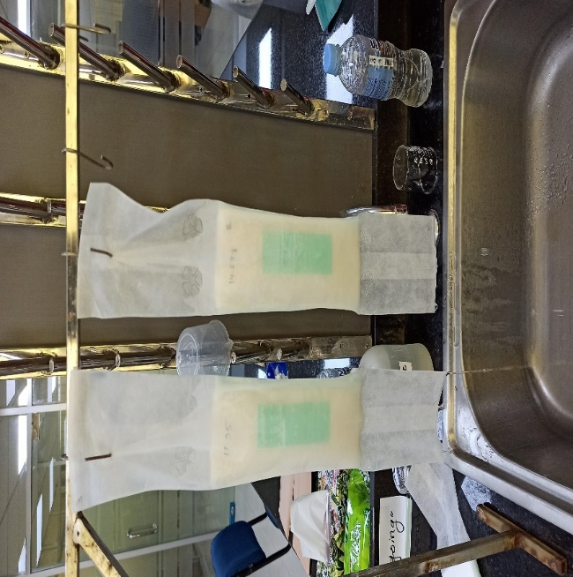
Absorption capacity test
The Sample was immersed into demineralised water for 30 min.
The sample hang vertically in a stand for 30 min to release the extra water by gravity.

Slide 16
Absorption Test result
The standard range of absorption is 95-105 mL

Slide 17
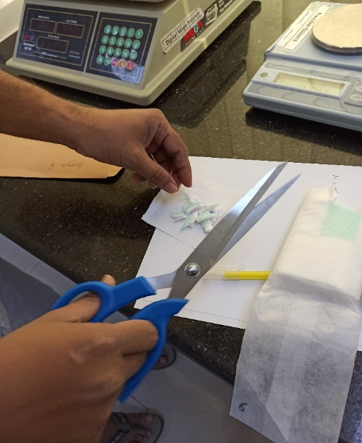
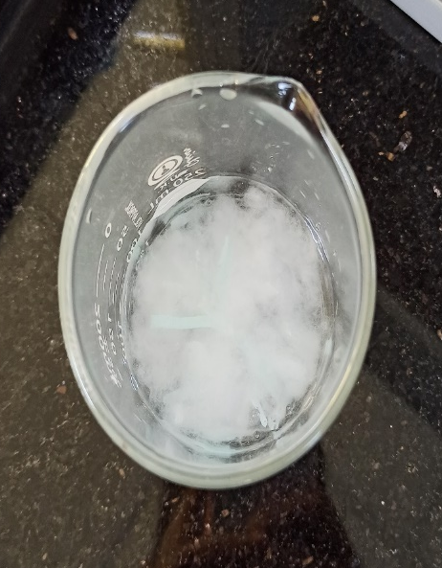
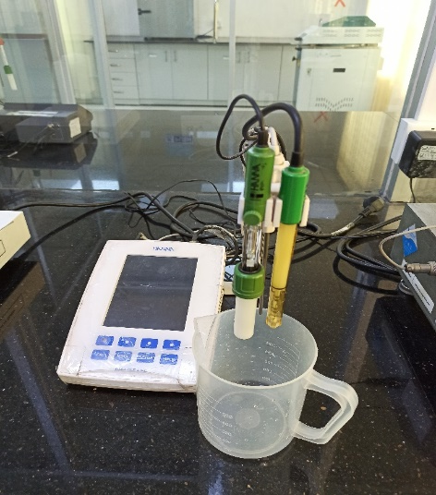
P^{h} test
0.5 gm sample was cut from core of the pad
and mixed with 100 ml demineralised Water for 1 hour.
After 1 hour the P^{H} was measured by P^{H} meter.

Slide 18
P^{H} Test result
The standard range of P^{H} is 5.5-8.5

Slide 19
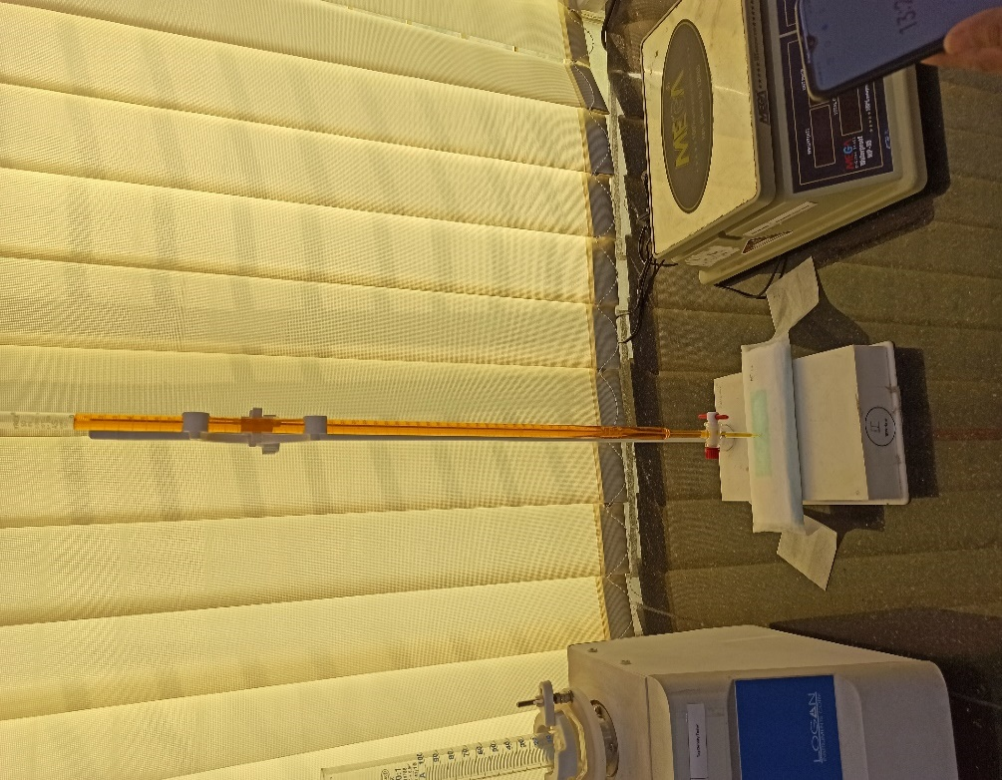
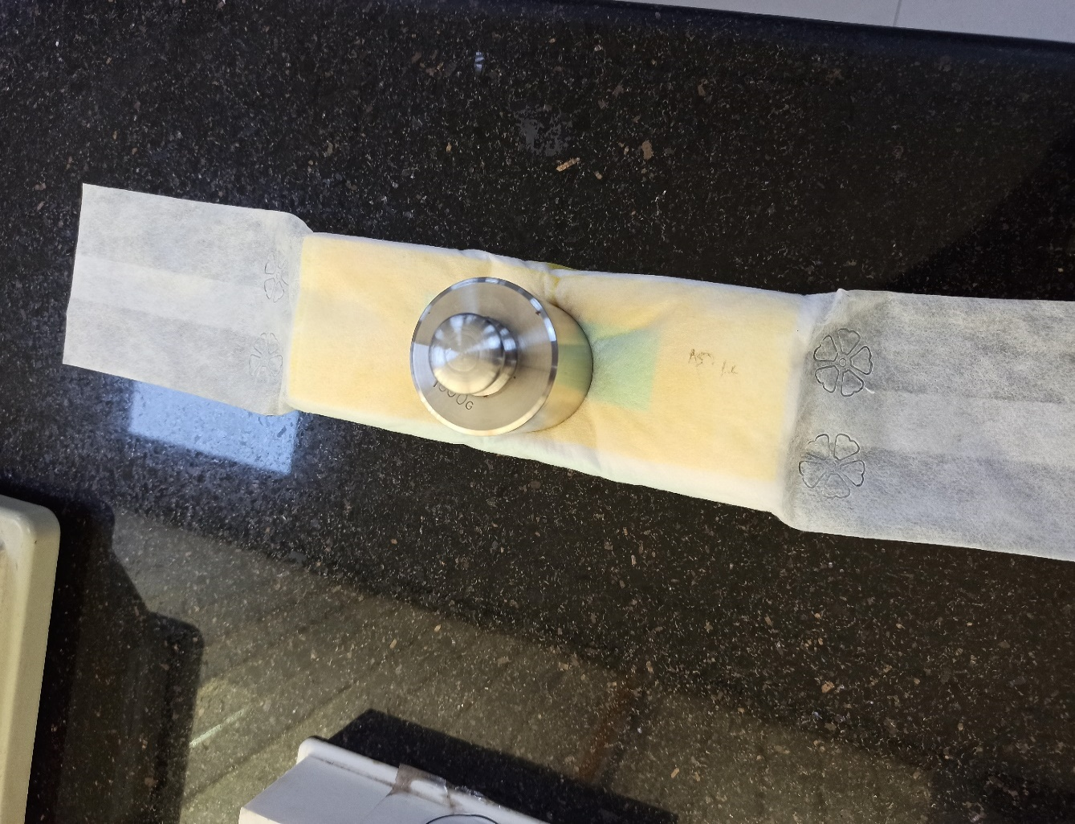
Ability To withstand Pressure After Absorption
30 ml K₂Cr₂O₇ (1% solution) was
poured on the sample.
Then 1 kg load was applied on the sample
for 1 minute.

Slide 20
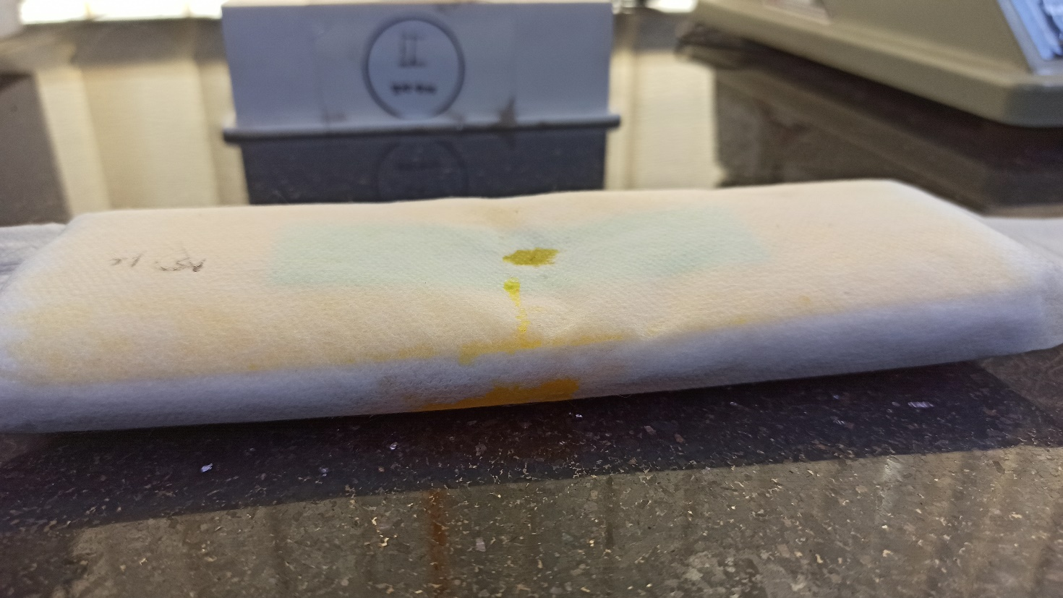
Ability To withstand Pressure After Absorption result
Liquid retention was comparatively low which causes side leakage

Slide 21
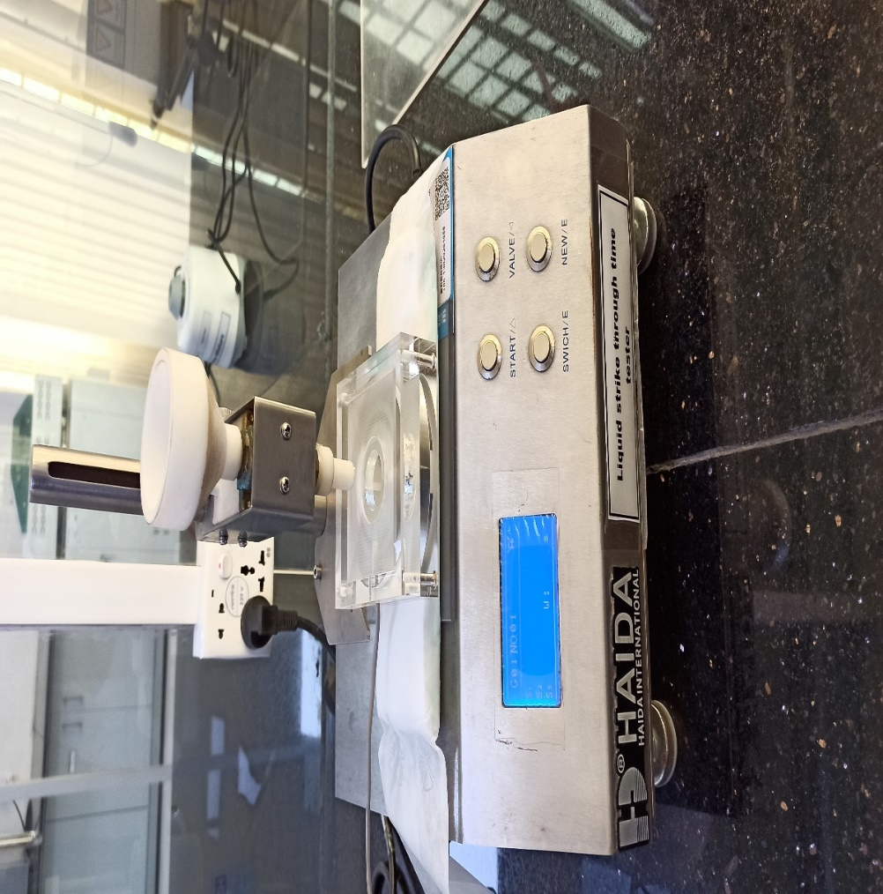
Penetration test
20 ml of 1% saline solution poured on the sample
with 3 ml/sec releasing speed.
Liquid Strike through Time Tester

Slide 22
Penetration Test result
The standard range of Penetration Time is 2-2.5 sec

Slide 23
Hydro gel Distribution
Top layer
Bottom layer

Slide 24
Cost Analysis
Cost of producing sanitary pad from recycled cotton
Materials & Factory Overhead | Price | Cost of making one pad
Textile Cotton Wastage | BDT 46/kg | BDT 0.46
PE sheet (bottom layer) | USD 2.96/kg BDT 250/kg | USD 0.0041 BDT 0.35
Non-woven (top layer) | USD 3.13/kg BDT 265/kg | USD 0.0044 BDT 0.37
Factory Overhead |  | BDT 1
 |  | Total = 2.16 BDT

Slide 25
Future Prospects
To attain more liquid retention fluff pulp will be mixed at different proportion to optimized the quality.
To get better performance and comfortability hydrogel arrangement will be improvised.
The non-biodegradable nonwoven outer and inner layer and the polyethylene back sheet will be replaced by biodegradable materials.
As diaper has the same requirement textile waste will also use in it.

Slide 26
THANKS
For Being With Us

